Slide 1

COMP1631 Advanced Spreadsheets – Winter 2024 – Section 06
Module 5

Slide 2
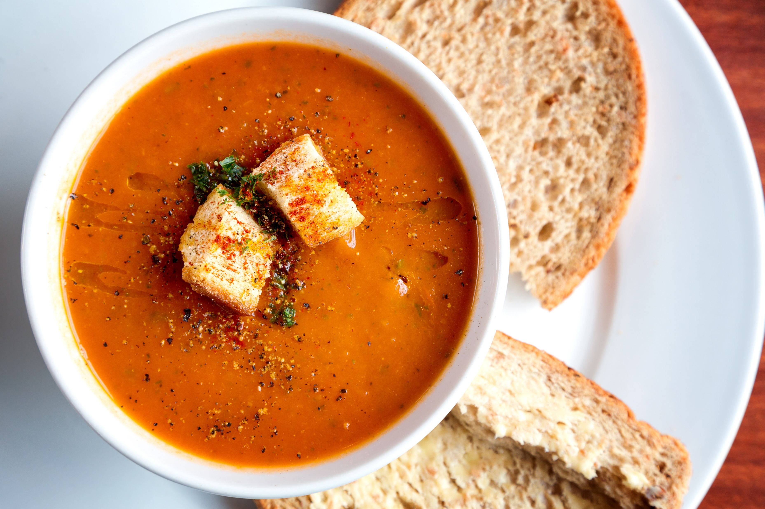
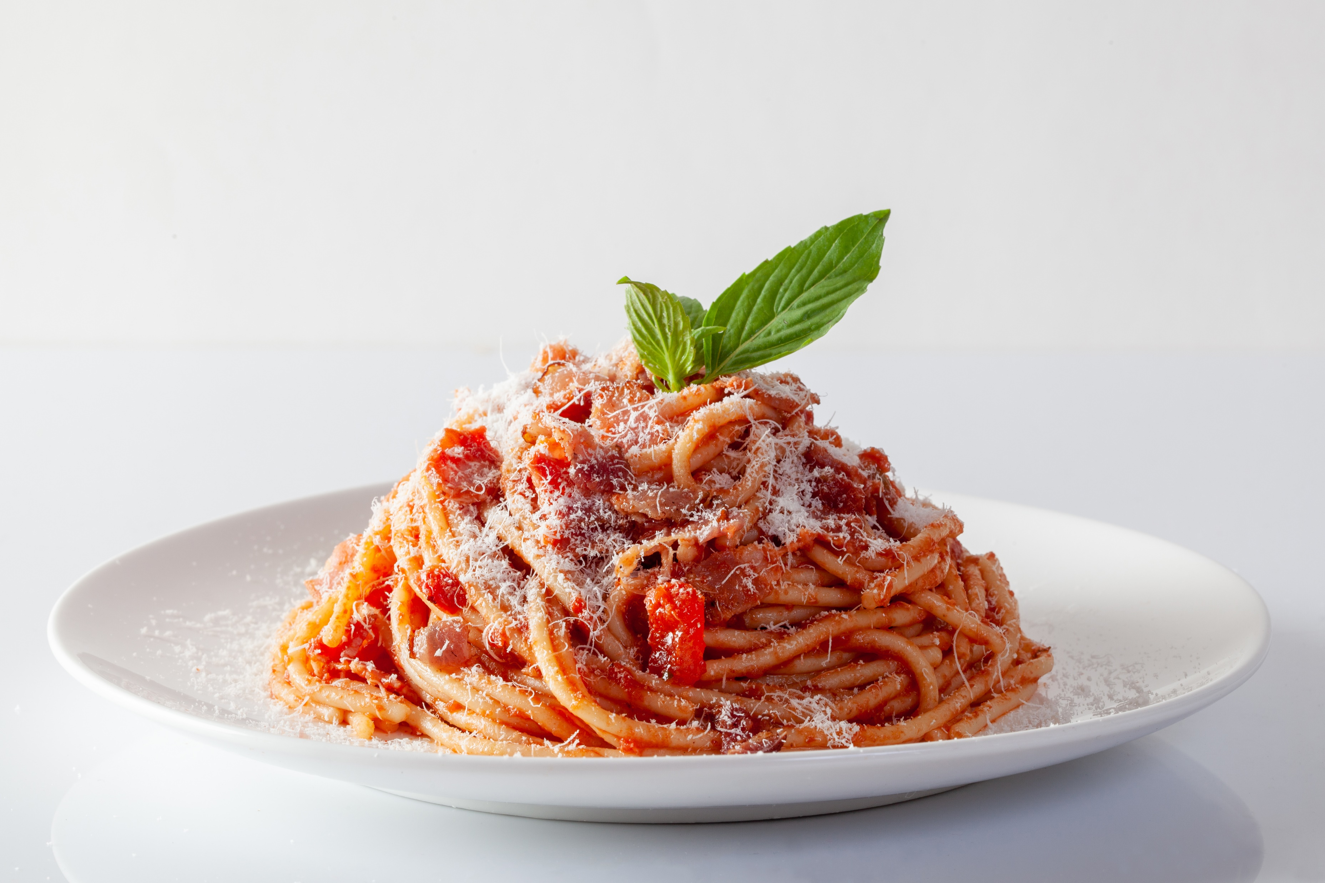

COMP1631 Advanced Spreadsheets – Winter 2024 – Section 06
Lecture 2 Tuesday, January 16, 2024
Today’s menu a la carte
Apéritifs
Module 5 Objectives
Plat principal
Quick check quiz
Review Modules 5
Desserts
Module 5 Textbook Project

Slide 3
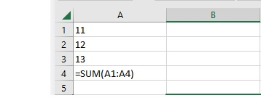
COMP1631 Advanced Spreadsheets – Winter 2024 – Section 06
Before we start
Quick Quiz from last class:
1. What is wrong with the formula shown?

Slide 4
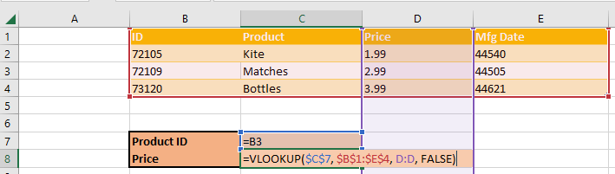
COMP1631 Advanced Spreadsheets – Winter 2024 – Section 06
Before we start
Quick Quiz from last class:
2. Correct the given VLOOKUP formula according to information shown?

Slide 5
COMP1631 Advanced Spreadsheets – Winter 2024 – Section 06
Module Objectives
Section 5.1
Copy worksheets between workbooks
View a workbook in multiple windows
Organize worksheets in a worksheet group
Write a 3-D reference
Section 5.2
Write an external reference
Manage the security features of linked documents
Create a hyperlink to a document source
Link to an email address
Section 5.3
Create and apply a named range
Work with name scope
Create a workbook template

Slide 6
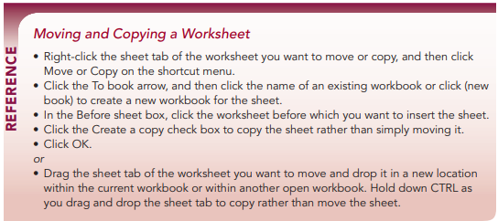
COMP1631 Advanced Spreadsheets – Winter 2024 – Section 06

Slide 7
COMP1631 Advanced Spreadsheets – Winter 2024 – Section 06
Quick Quiz:
What is the first step in copying worksheets to another workbook?
True/False. The fastest way to copy an entire worksheet to press and hold the Alt key as you drag and drop the sheet tab.

Slide 8
COMP1631 Advanced Spreadsheets – Winter 2024 – Section 06
Quick Quiz:
What is the first step in copying worksheets to another workbook?
(Answer: select the sheet tabs you want to copy)
True/False. The fastest way to copy an entire worksheet to press and hold the Alt key as you drag and drop the sheet tab.
(Answer: False)

Slide 9
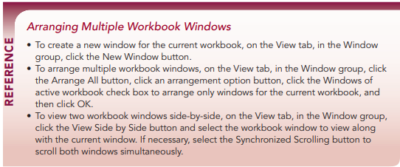
COMP1631 Advanced Spreadsheets – Winter 2024 – Section 06

Slide 10
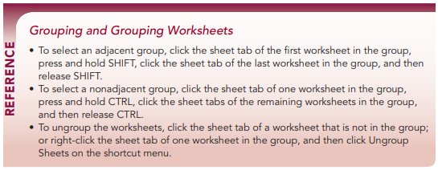
COMP1631 Advanced Spreadsheets – Winter 2024 – Section 06

Slide 11
COMP1631 Advanced Spreadsheets – Winter 2024 – Section 06

Slide 12
COMP1631 Advanced Spreadsheets – Winter 2024 – Section 06

Slide 13
COMP1631 Advanced Spreadsheets – Winter 2024 – Section 06

Slide 14
COMP1631 Advanced Spreadsheets – Winter 2024 – Section 06

